Slide 1
Adventure Works Project Conclusion – Team 5

Slide 2
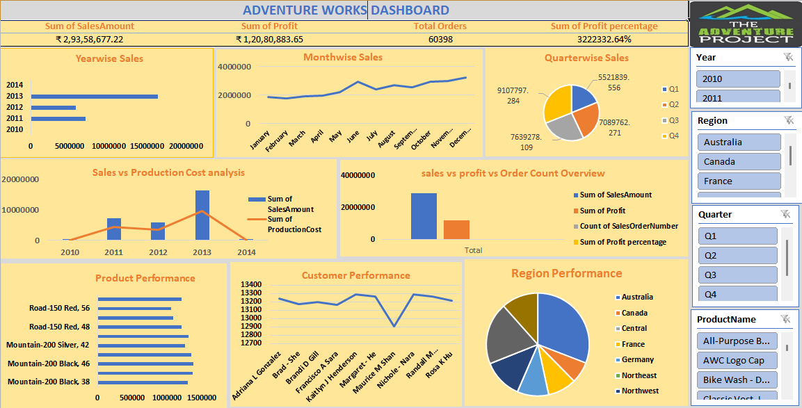
KPI Cards
Charts
Slicers

Slide 3
Elements Used in Dashboards
KPI Cards - Key Performance Indicator Cards -simple visual elements used to display important metrics in a clear and highlighted way.
Why are KPI Cards used?
Quickly understand business performance
Highlight important numbers at a glance
Support decision-making
Make dashboards look professional
Slicers- visual filter buttons used in Excel to quickly filter data
Why are Slicers used?
Filter data with one click
Make dashboards interactive
Improve data analysis speed
Show current filter selection clearly
Charts- graphical representations of data that help you understand numbers quickly and easily.
Why are Charts used?
Visualize data clearly
Identify trends and patterns
Compare values easily
Make data easier to understand
Support better decision-making

Slide 4
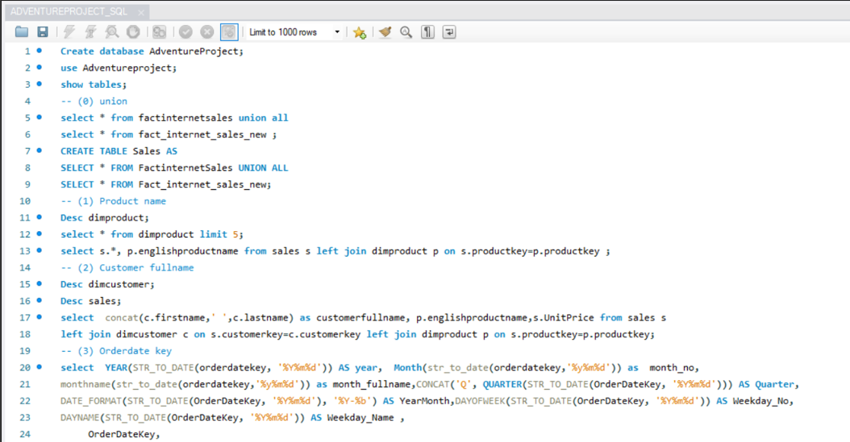
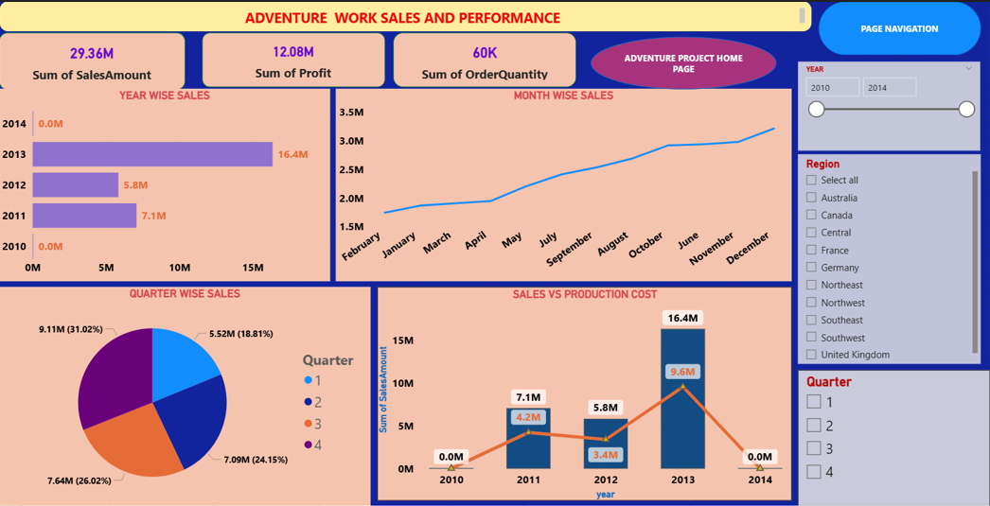
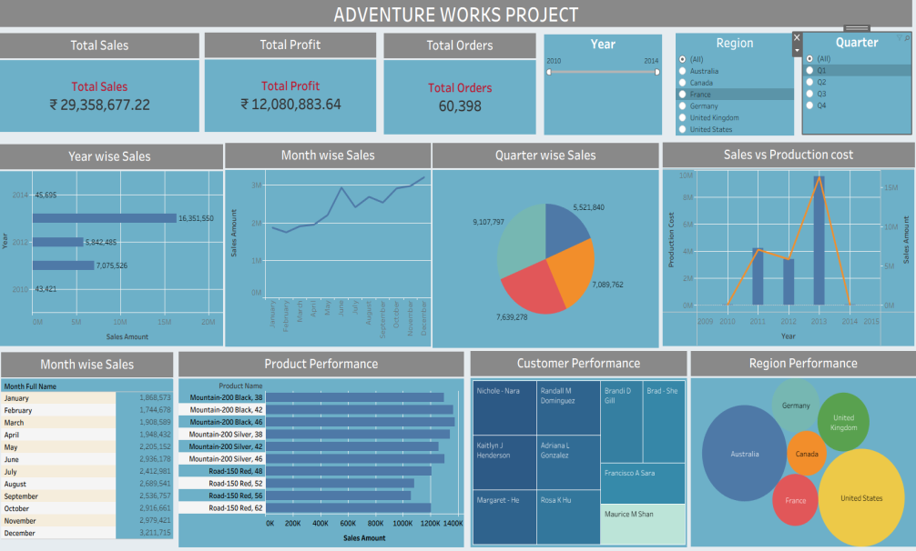

Slide 5
Step-by-Step Project Explanation
The goal is to convert raw data into meaningful insights for better business decision-making.
Data Preparation:
First, we have connected multiple data sources like:
Fact Internet Sales, New Sales Data, Product Data, Customer Data etc.
Combined sales tables and used Joins/Relationships to bring in product and customer details.
Data Cleaning & Transformation
Handled missing values and ensured consistency in Column names and Data types.
Asset Creation and Integration:
Create the assets like KPI cards, charts, etc. based on the questions.
Bring all data into Dashboard and aligned to make it user friendly

Slide 6
Merits and Demerits
Merits
Accountability
Proper Validation
Improved Efficiency
Collaboration
Demerits
Lack of clarity on requirements
Lack of standardization in terms alignment
Tool & Version Conflicts

Slide 7
Thank You

